Slide 1
Handling Navigation with Routes

Slide 2
Objectives
Set up the router module to enable navigation among multiple component views
Set up the routes to enable the navigation
Client vs. Server Side

Slide 3
React router
Collection of navigational components
Enables navigation among views
Router components, route matching components and navigation components
Uses a browser-based bookmarkable URLs as an instruction to navigate to a client-generated view in your web app
Can also pass along optional parameters

Slide 4
Introduction of a Router
Almost every web application requires routing: the process of responding to a URL, based on a set of route handler declarations. In other words, this is a mapping from the URL to rendered content.
Include:
Declaring routes
Handling route parameters
Using link components

Slide 5
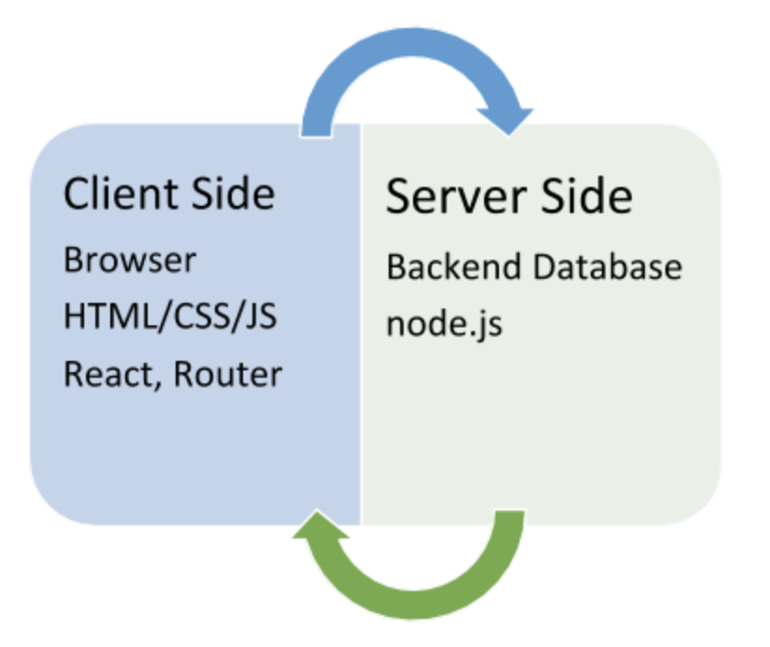
Client vs. Server Side
We can’t have a conversation about routing and React Router without mentioning client side and server side.
Client side is the browser. Its processing happens on the local machine.
Server side is where the information is processed and then sent through to a browser.

Slide 6
Router components
<BrowserRouter> stores the current location in the browser's address bar using clean URLs and navigates using the browser's built-in history stack.
<HashRouter> is for use in web browsers when the URL should not (or cannot) be sent to the server for some reason. This may happen in some shared hosting scenarios where you do not have full control over the server. In these situations, <HashRouter> makes it possible to store the current location in the hash portion of the current URL, so it is never sent to the server.
A <MemoryRouter> stores its locations internally in an array. Unlike <BrowserHistory> and <HashHistory>, it isn't tied to an external source, like the history stack in a browser. This makes it ideal for scenarios where you need complete control over the history stack, like testing.
<StaticRouter> is used to render a React Router web app in node. Provide the current location via the location prop.
<NativeRouter> is the recommended interface for running React Router in a React Native app.

Slide 7
Web App Routing – using <BrowserRouter>
npm install react-router-dom
Router component: <BrowserRouter>
Enclose your app in <BrowserRouter> </BrowserRouter>
import { BrowserRouter } from 'react-router-dom';
<BrowserRouter>
<App />
</BrowserRouter>

Slide 8
Route Matching
Route matching components: <Routes> and <Route>
<Route>’s path prop enables specification of the current location’s pathname
<Route>’s component prop specifies the corresponding view for the location
Using exact attribute ensures that the path must be exactly matched
<Route> enables grouping together several routes
Syntax: <Route path='/' element={component}></Route>
import { Routes, Route } from "react-router-dom";
<Routes>
<Route path='/' element={<Orchids/>}></Route>
<Route path='/detail/:id'element={<OrchidDetail/>}></Route>
</Routes>

Slide 9
<Routes> component
Rendered anywhere in the app, <Routes> will match a set of child routes from the current location.
Whenever the location changes, <Routes> looks through all its child routes to find the best match and renders that branch of the UI. <Route> elements may be nested to indicate nested UI, which also correspond to nested URL paths
<Routes>
<Route path="/" element={<Dashboard />}>
<Route
path="messages"
element={<DashboardMessages />}
/>
<Route path="tasks" element={<DashboardTasks />} />
</Route>
<Route path="about" element={<AboutPage />} />
</Routes>

Slide 10
<Outlet> component
An <Outlet> should be used in parent route elements to render their child route elements. This allows nested UI to show up when child routes are rendered. If the parent route matched exactly, it will render a child index route or nothing if there is no index route.
function Dashboard() {
return (
<div>
<h1>Dashboard</h1>
{/* This element will render either <DashboardMessages> when the URL is "/messages", <DashboardTasks> at "/tasks", or null if it is "/"
*/}
<Outlet />
</div>
);
}
function App() {
return (
<Routes>
<Route path="/" element={<Dashboard />}>
<Route
path="messages"
element={<DashboardMessages />}
/>
<Route path="tasks" element={<DashboardTasks />} />
</Route>
</Routes>
);
}

Slide 11
<Link> component
A <Link> is an element that lets the user navigate to another page by clicking or tapping on it. In react-router-dom, a <Link> renders an accessible <a> element with a real href that points to the resource it's linking to. This means that things like right-clicking a <Link> work as you'd expect. You can use <Link reloadDocument> to skip client side routing and let the browser handle the transition normally (as if it were an <a href>).
import * as React from "react";
import { Link } from "react-router-dom";
function UsersIndexPage({ users }) {
return (
<div>
<h1>Users</h1>
<ul>
{users.map((user) => (
<li key={user.id}>
<Link to={user.id}>{user.name}</Link>
</li>
))}
</ul>
</div>
);
}

Slide 12
<NavLink> component
A <NavLink> is a special kind of <Link> that knows whether or not it is "active", "pending", or "transitioning". This is useful in a few different scenarios:
When building a navigation menu, such as a breadcrumb or a set of tabs where you'd like to show which of them is currently selected
It provides useful context for assistive technology like screen readers
It provides a "transitioning" value to give you finer-grained control over View Transitions
import { NavLink } from "react-router-dom"; <NavLink
to="/messages"
className={({ isActive, isPending }) =>
isPending ? "pending" : isActive ? "active" : ""
}
>
Messages
</NavLink>;

Slide 13
<Navigate> component
import { useState } from 'react';
import { useNavigate } from 'react-router-dom'; function LoginForm() {
const [user, setUser] = useState(null);
const [error, setError] = useState(null);
const navigate = useNavigate(); async function handleSubmit(event) {
event.preventDefault();
try {
let user = await login(event.target);
setUser(user);
} catch (error) {
setError(error);
}
} return (
<div>
{error && <p>{error.message}</p>}
{user && <Navigate to="/dashboard" replace={true} />}
<form onSubmit={(event) => handleSubmit(event)}>
<input type="text" name="username" />
<input type="password" name="password" />
</form>
</div>
);
}
export default LoginForm;
A <Navigate> element changes the current location when it is rendered. It's a component wrapper around useNavigate, and accepts all the same arguments as props.

Slide 14
Hooks
The useLocation returns the current location object.
The useNavigate returns a function that lets you navigate programmatically.
The useParams hook returns an object of key/value pairs of the dynamic params from the current URL that were matched by the <Route path>. Child routes inherit all params from their parent routes.
The useSearchParams hook is used to read and modify the query string in the URL for the current location.
The useRoutes hook is the functional equivalent of <Routes>, but it uses JavaScript objects instead of <Route> elements to define your routes. These objects have the same properties as normal <Route> elements, but they don't require JSX.

Slide 15
useLocation - Demo
import * as React from 'react';
import { useLocation } from 'react-router-dom';
function App() {
let location = useLocation();
React.useEffect(() => {
// Google Analytics
ga('send', 'pageview');
}, [location]);
return (
// ...
);
}

Slide 16
useNavigate - Demo
import { useNavigate } from "react-router-dom";
function useLogoutTimer() {
const userIsInactive = useFakeInactiveUser();
const navigate = useNavigate();
useEffect(() => {
if (userIsInactive) {
fake.logout();
navigate("/session-timed-out");
}
}, [userIsInactive]);
}

Slide 17
useParams - Demo
import * as React from 'react';
import { Routes, Route, useParams } from 'react-router-dom';
function ProfilePage() {
// Get the userId param from the URL.
let { userId } = useParams();
// ...
}
function App() {
return (
<Routes>
<Route path="users">
<Route path=":userId" element={<ProfilePage />} />
<Route path="me" element={...} />
</Route>
</Routes>
);
}

Slide 18
useSearchParams - Demo
import * as React from "react";
import { useSearchParams } from "react-router-dom";
function App() {
let [searchParams, setSearchParams] = useSearchParams();
function handleSubmit(event) {
event.preventDefault();
// The serialize function here would be responsible for
// creating an object of { key: value } pairs from the
// fields in the form that make up the query.
let params = serializeFormQuery(event.target);
setSearchParams(params);
}
return (
<div>
<form onSubmit={handleSubmit}>{/* ... */}</form>
</div>
);
}

Slide 19
useRoutes - Demo
import * as React from "react";
import { useRoutes } from "react-router-dom";
function App() {
let element = useRoutes([
{
path: "/",
element: <Dashboard />,
children: [
{
path: "messages",
element: <DashboardMessages />,
},
{ path: "tasks", element: <DashboardTasks /> },
],
},
{ path: "team", element: <AboutPage /> },
]);
return element;
}

Slide 20
Route Parameters
Paths specified as a URL
Paths can also carry parameter values: e.g., /orchids/3 where 3 is a route parameter
Route parameters specified in the path specification as a token
e.g., path: ‘orchid/:id’ where id is the token
import { Link } from 'react-router-dom'
<Link to={`detail/${orchid.id}`}> <p><button>Detail</button></p></Link>

Slide 21
Route Parameters
Route parameters can be specified using a link parameter while specifying the link
e.g., <Link to={`/orchid/${orchid.id}`} >
Using ‘useParams’ Hook to returns an object of key/value pairs of the dynamic params from the current URL that were matched by the <Route path>
import { useParams } from ‘react-router-dom’
const orchidId = useParams();
const orchid = data.find(obj => {
return obj.id === orchidId.id;
});

Slide 22
Summary
Concepts were introduced:
Set up the router module to enable navigation among multiple component views
Set up the routes to enable the navigation
Client vs. Server Side

